Slide 1
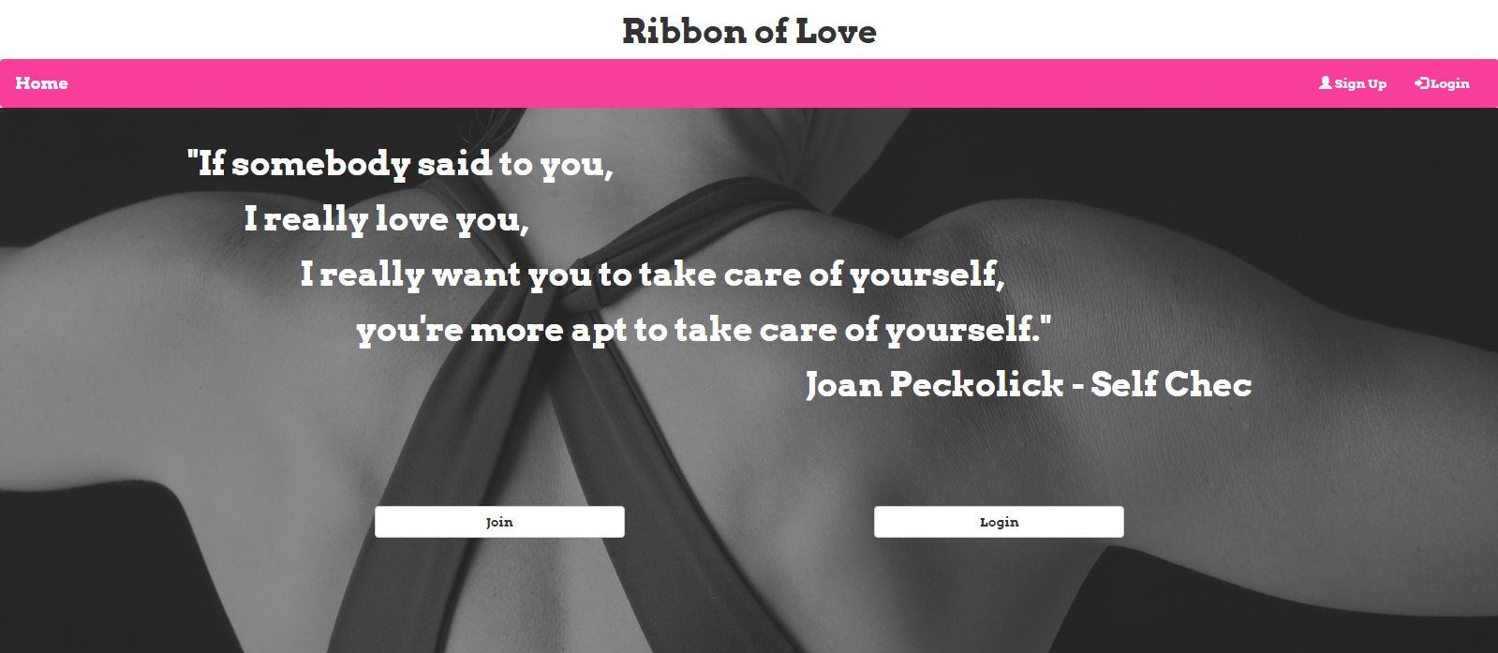

Slide 2
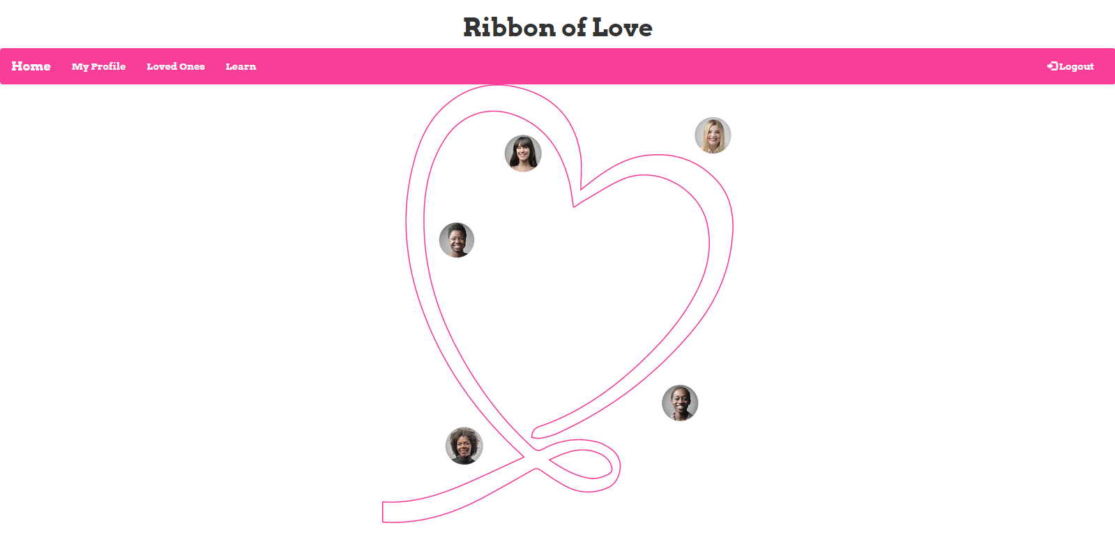

Slide 3


Slide 4


Slide 5
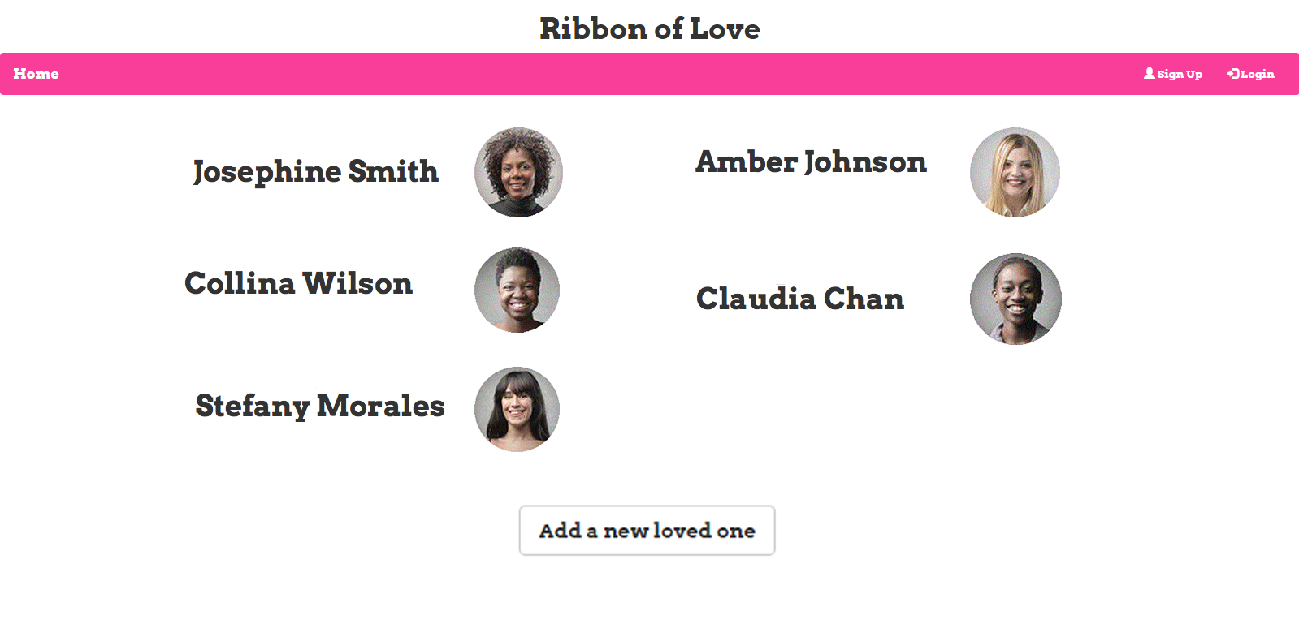

Slide 6


Slide 7
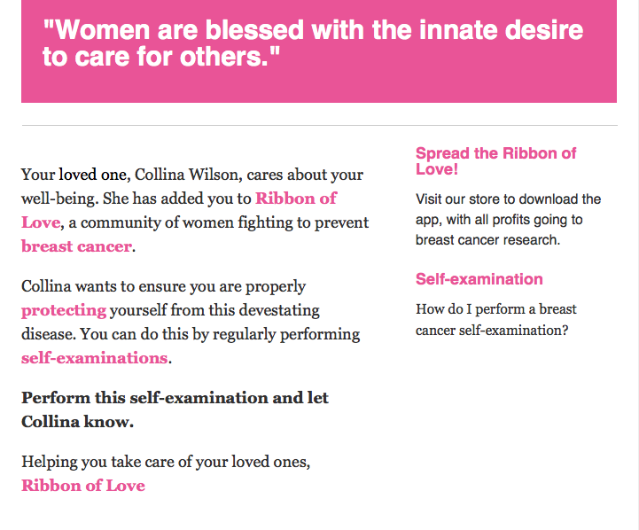

Slide 8
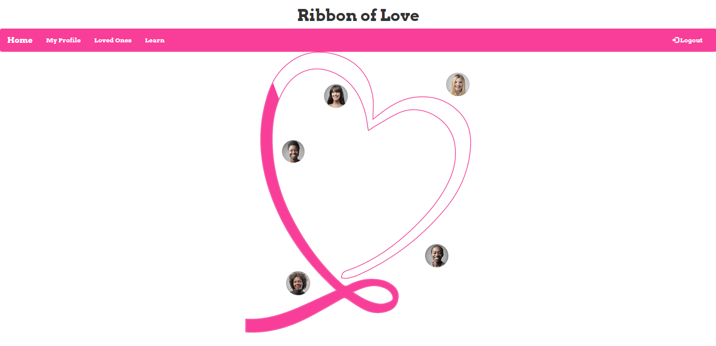

Slide 9
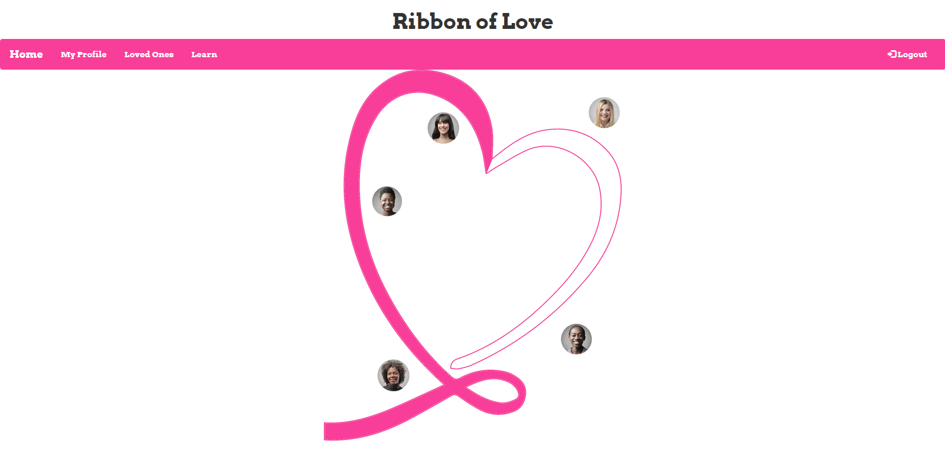

Slide 10
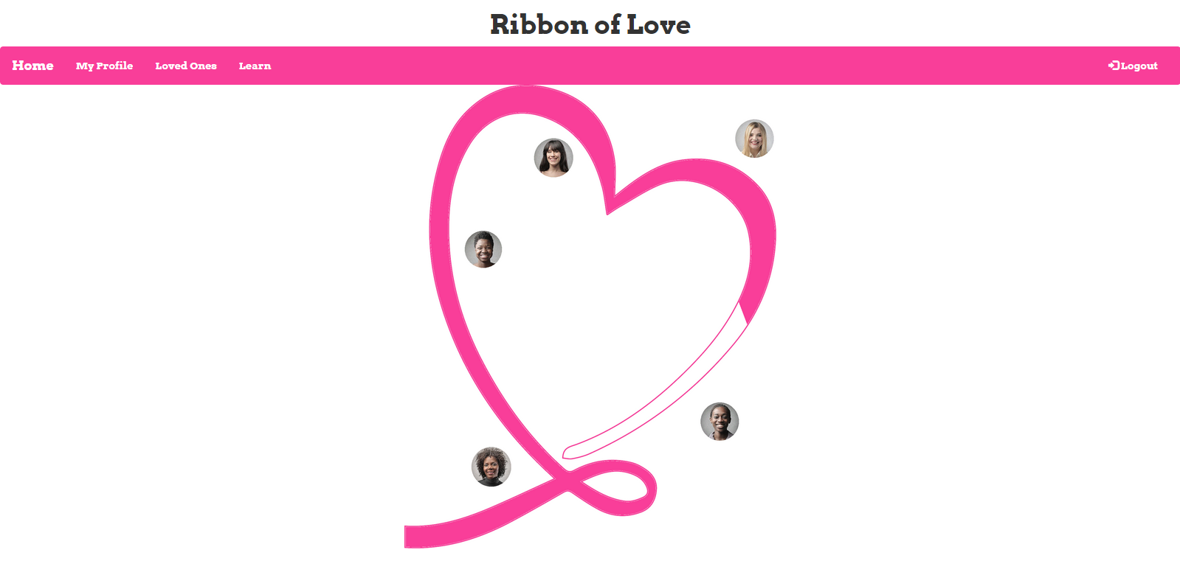

Slide 11
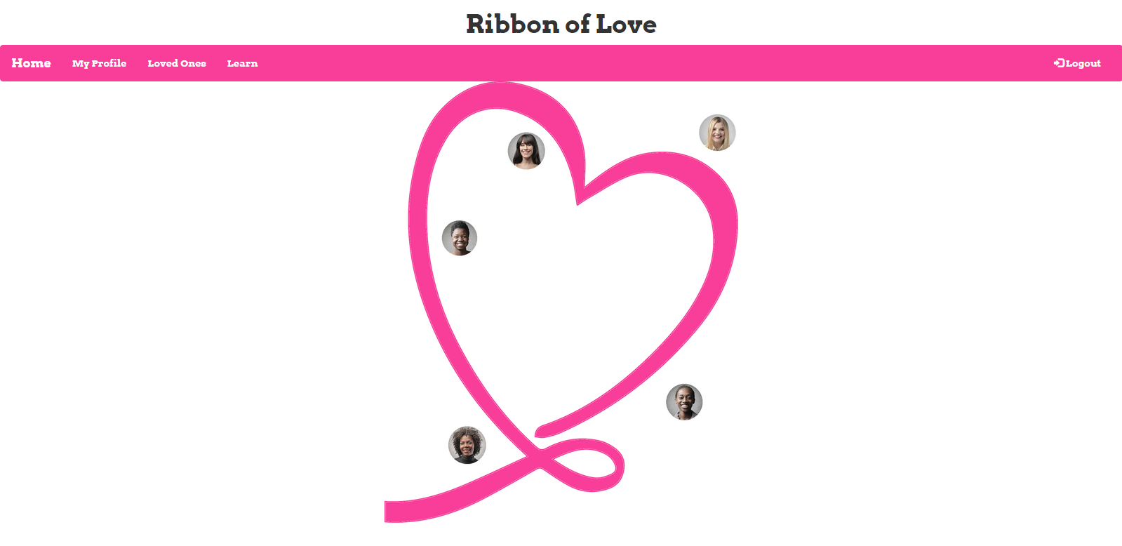

Slide 12

Credits:
Jeff DeVince - Web & Back-end Development
Olivia James - Content Management & Presentation
Tiffany Lambert - Database Implementation & Video Editing
Caridad Zegarra - Wire Frames & CSS Styling

